Slide 1


Day 2: Using microcontrollers
Introduction to breadboards, Arduinos and ESP32 cameras.
Notes:
Feel free to ask questions and collaborate

Slide 2
Day 2 Content
Introduction to breadboards
Programming the Arduino
Using the ESP32 camera

Slide 3
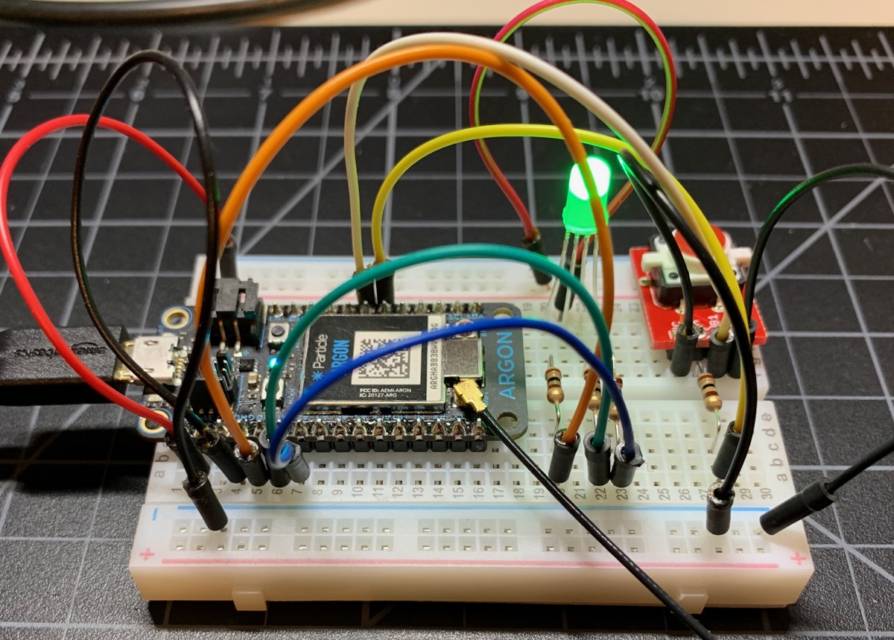
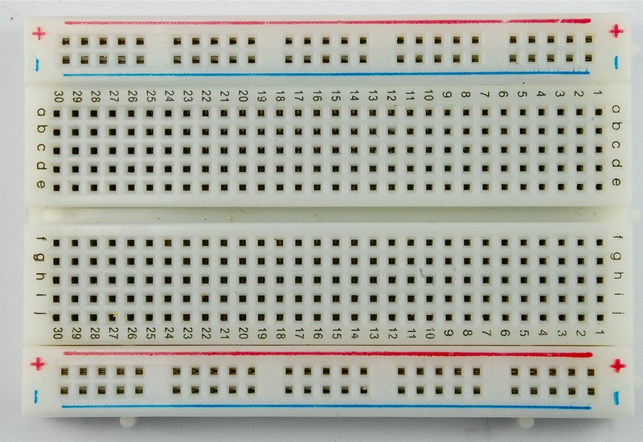
Breadboards

Slide 4
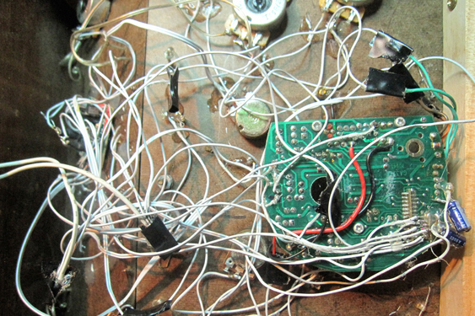
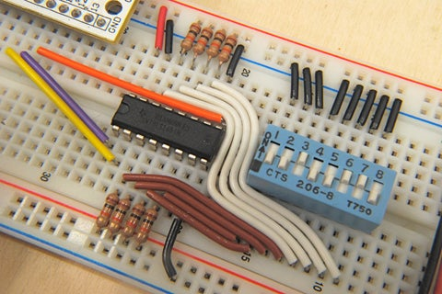
Breadboards: Why do we use them?

Slide 5
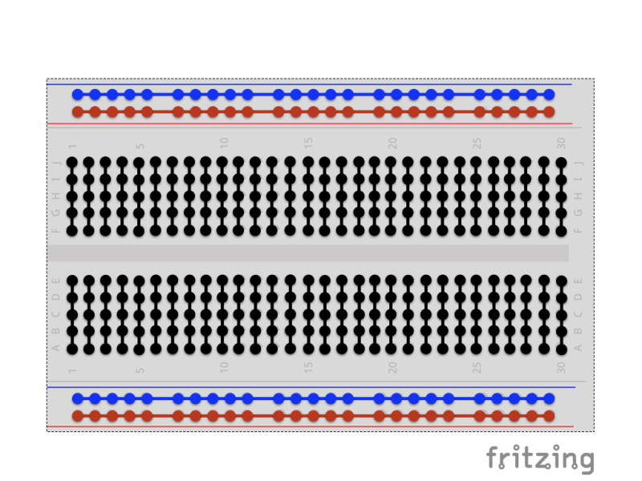
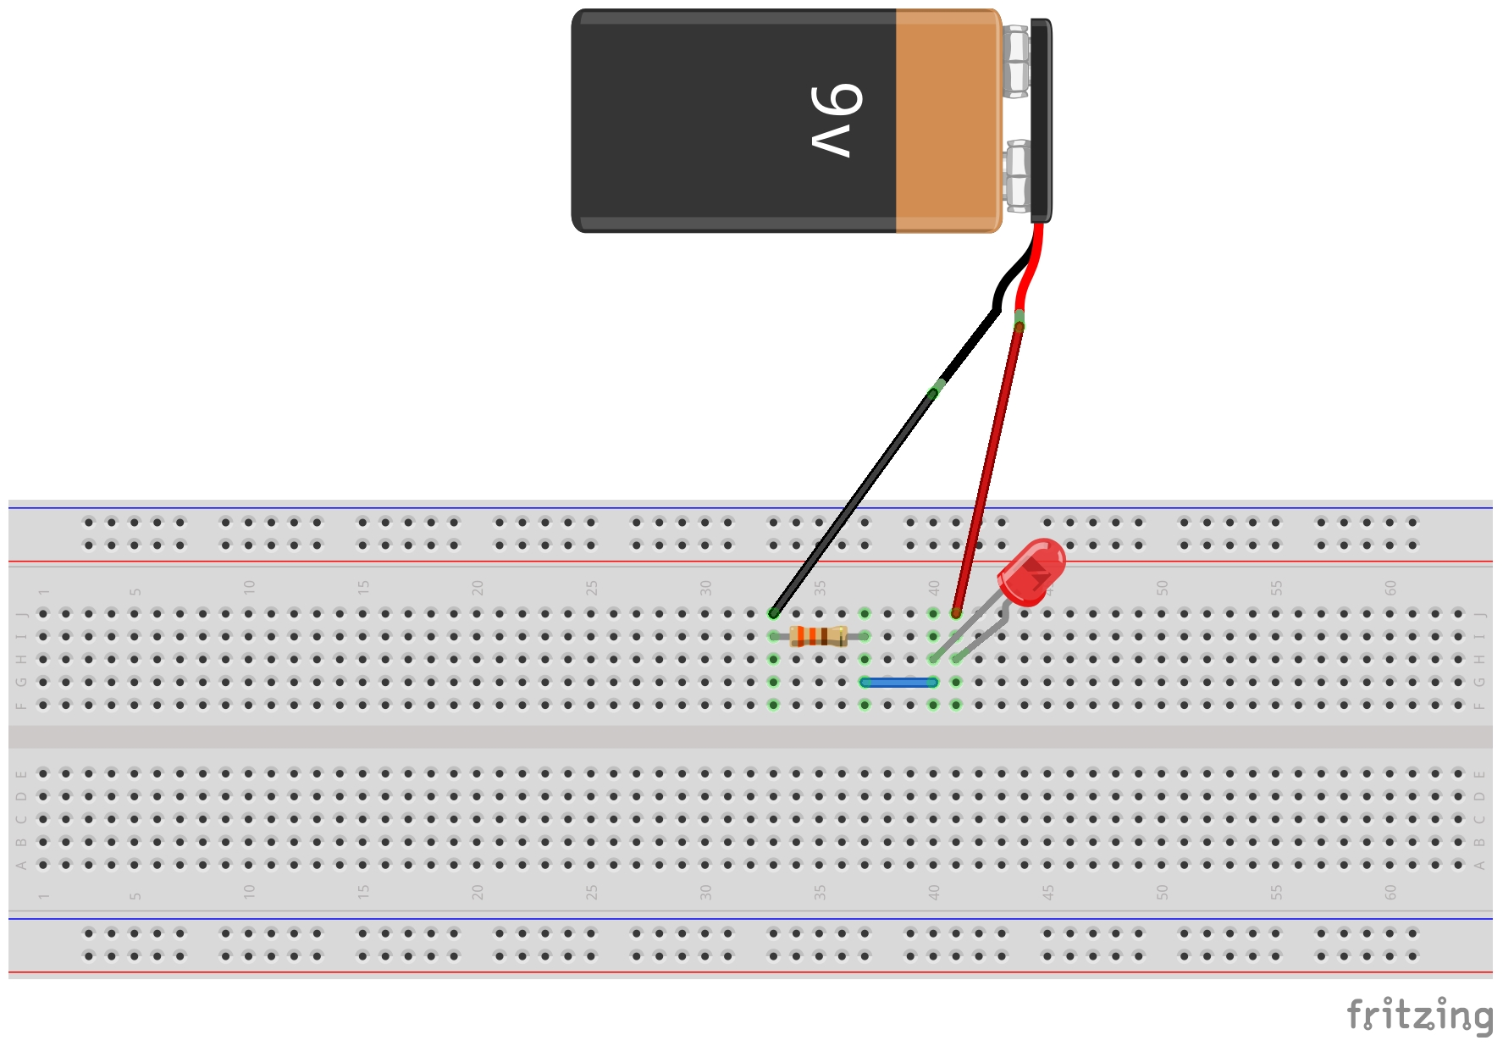
Breadboards: How do they work?

Slide 6
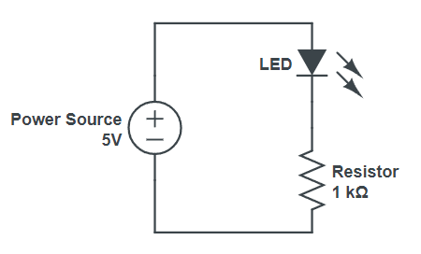
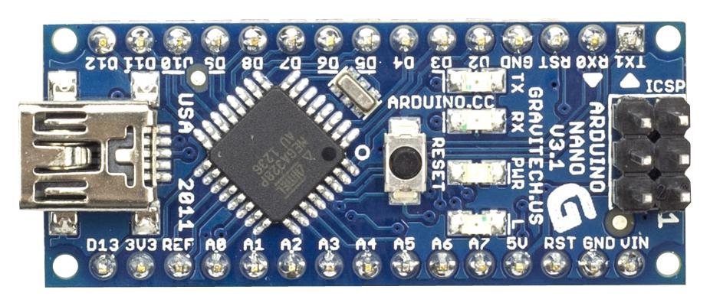
Activity Time
Turn on an LED on the breadboard
5V
GND
+
-

Slide 7
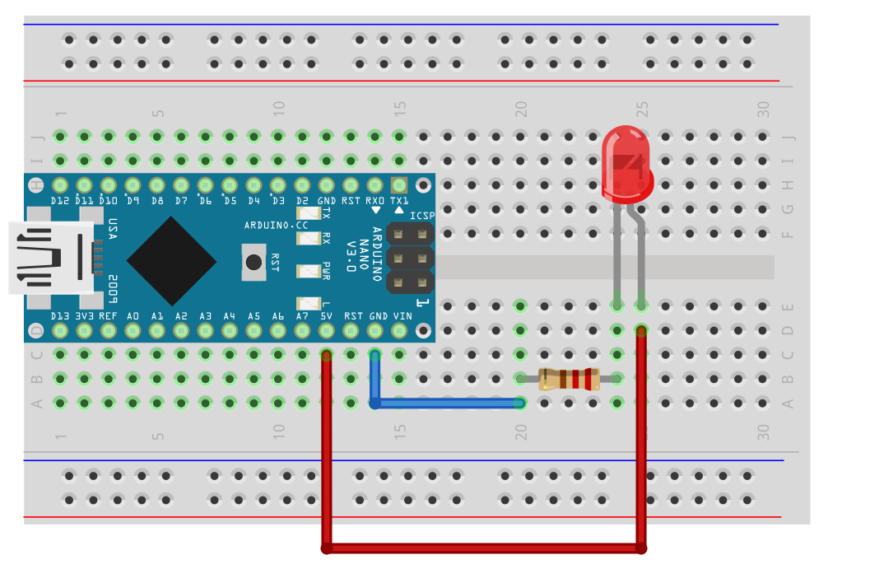
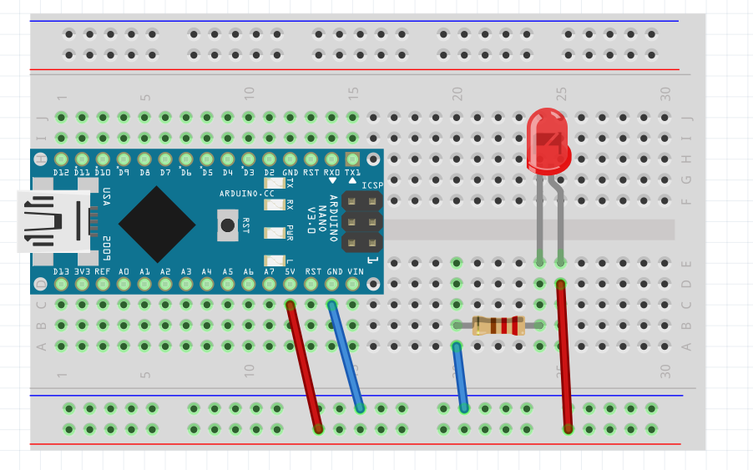
Activity Time: Solution

Slide 8
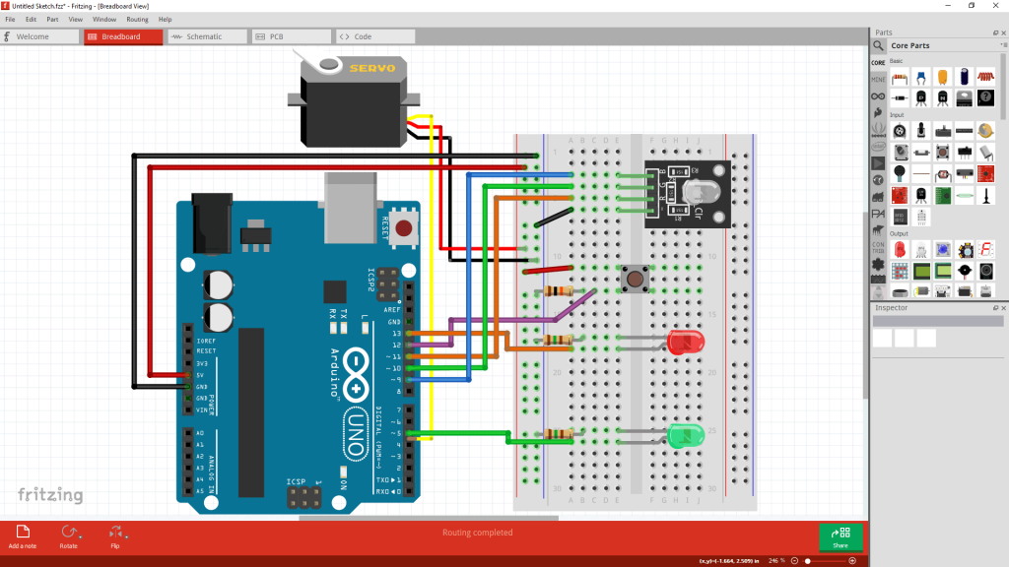
Fritzing Demo
Notes:
Change this to a circuit of a red led. Electrical circuit vs breadboard

Slide 9
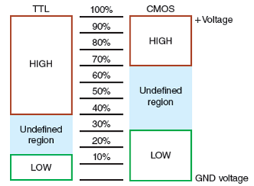
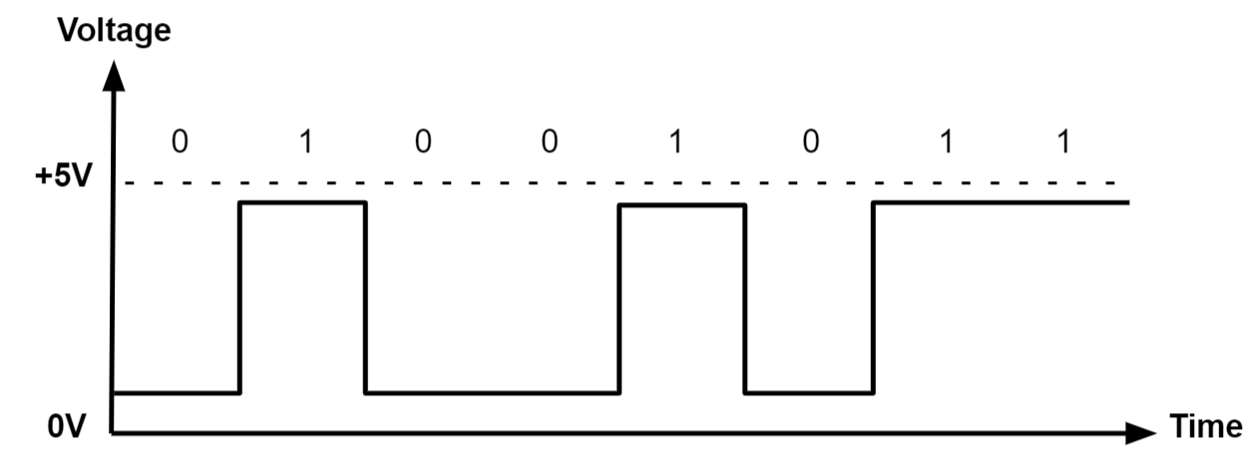
Digital Logic
Notes:
Transisotr transistor logic
Complementary metal-oxide-semiconductor

Slide 10
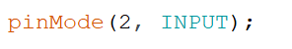
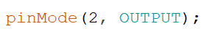
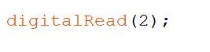
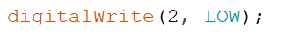
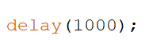
Programming Basics
Notes:
Fix circuit and create a better code explanation

Slide 11
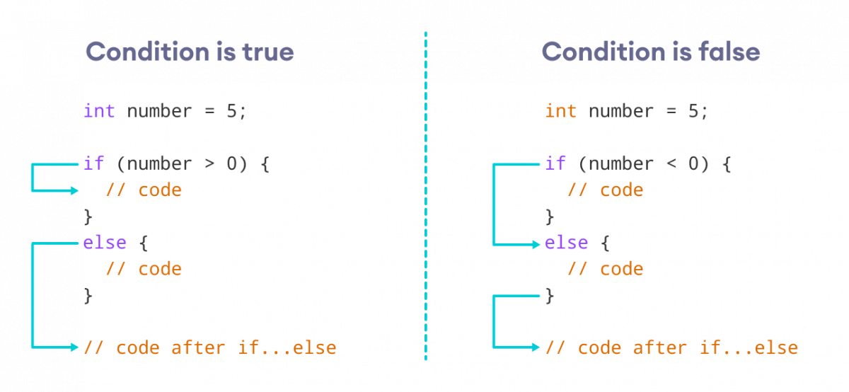
If-else statements
Notes:
Fix circuit and create a better code explanation

Slide 12

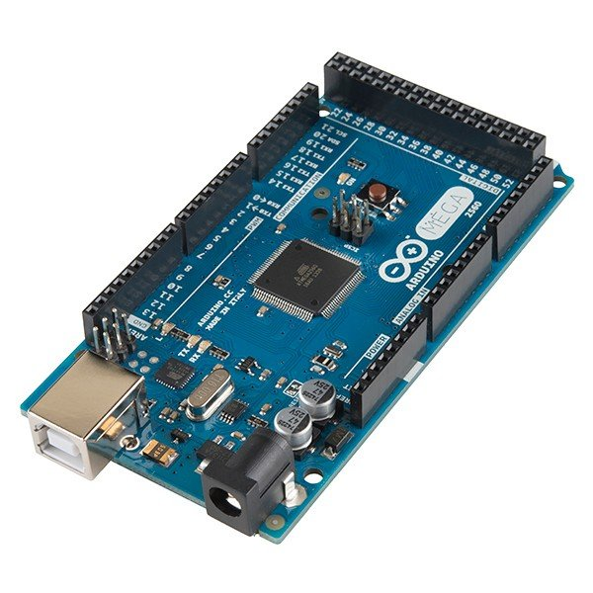
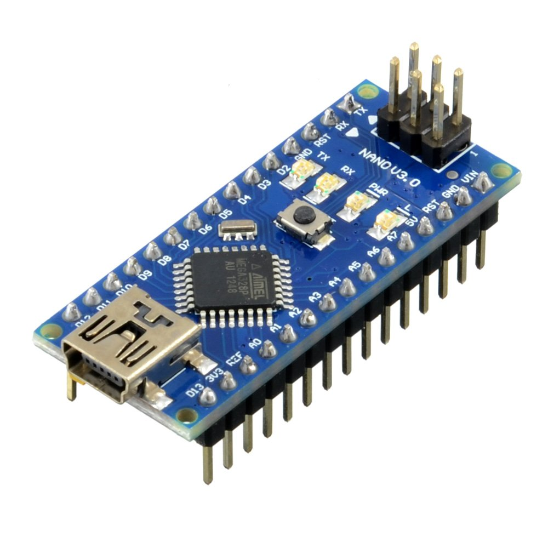
Arduino
Arduino Nano
Arduino Uno
Arduino Mega

Slide 13
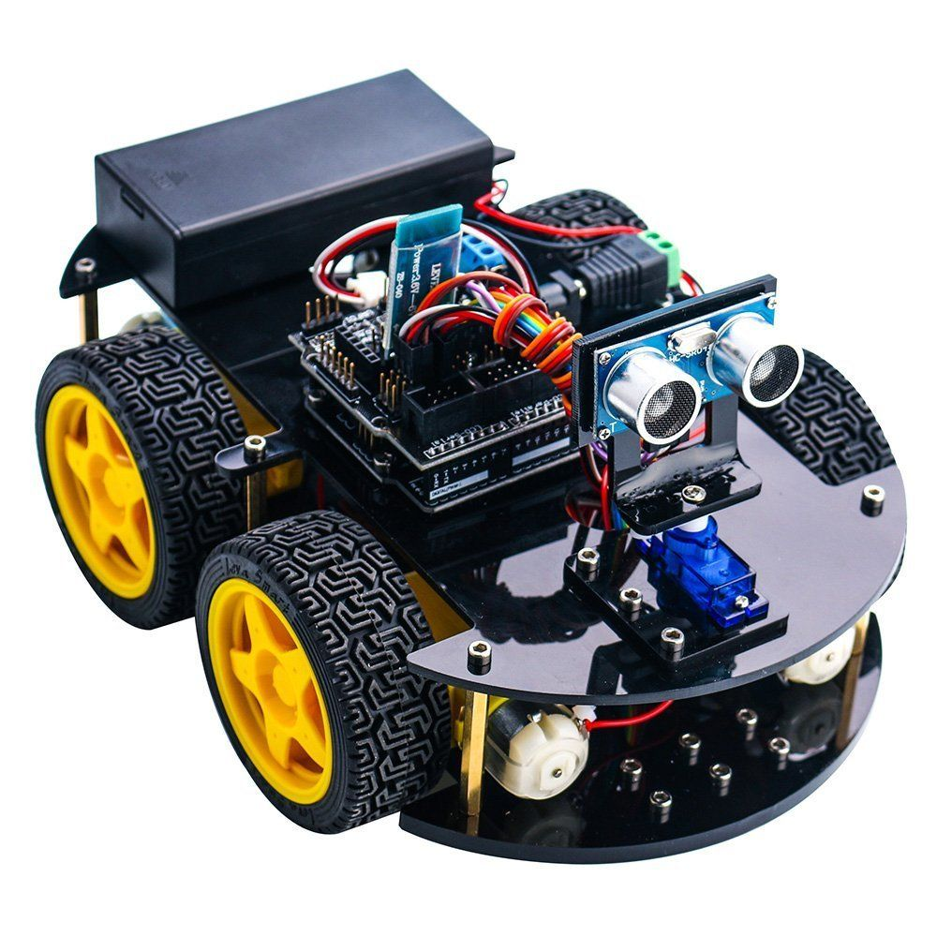
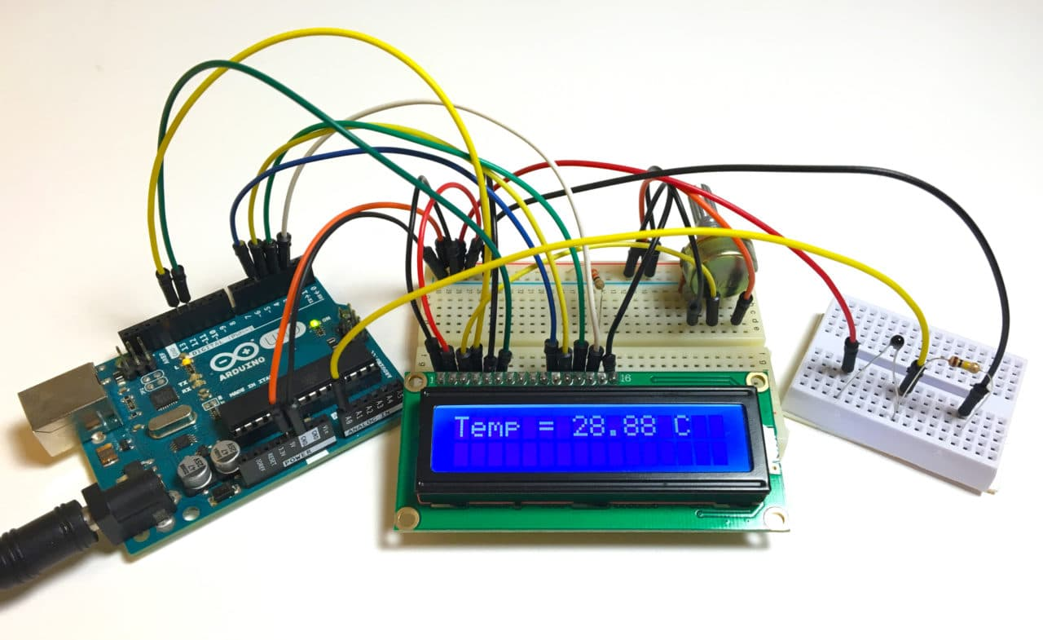
Arduino Example Projects

Slide 14
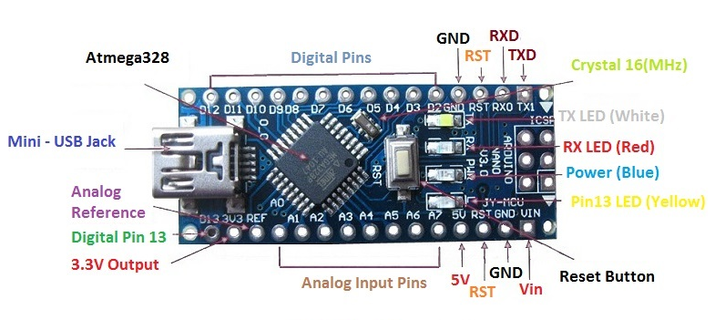
Arduino Nano: Labelled

Slide 15
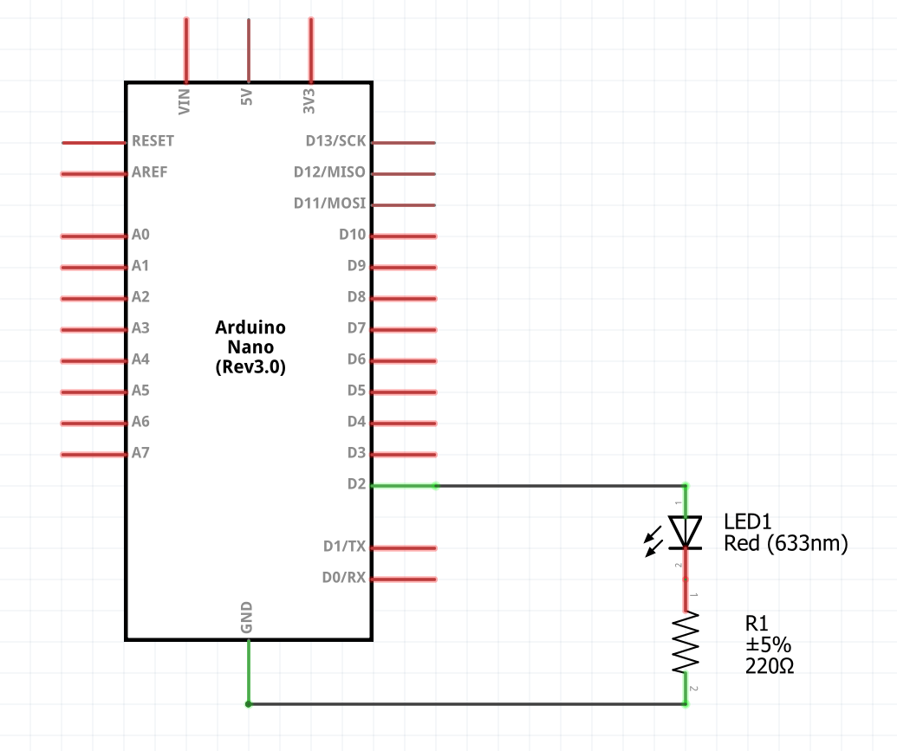
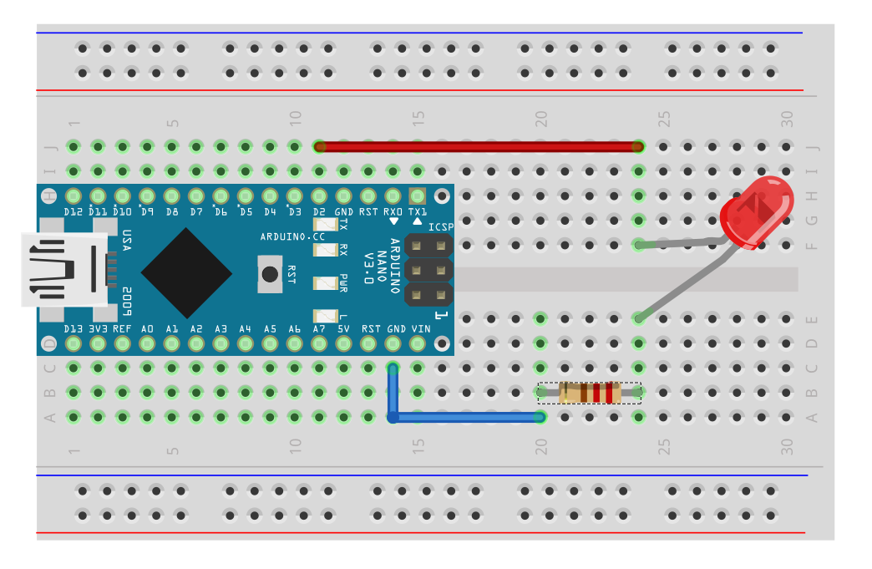
Arduino Nano: Blinking LED circuit
Notes:
Remove extra wire on D3

Slide 16
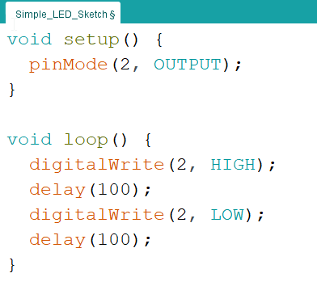
Arduino Nano: Programming the simple LED

Slide 17

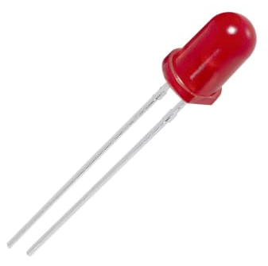
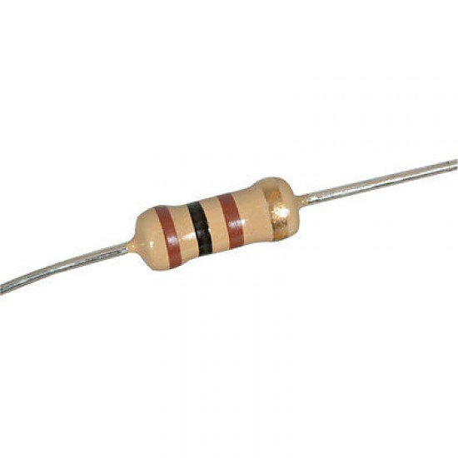
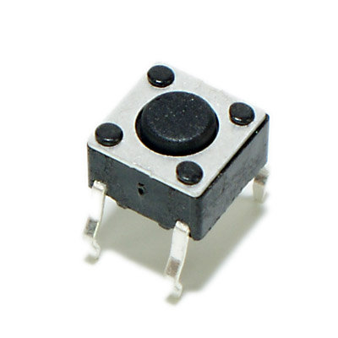
Activity Time!
Create a circuit to turn an LED ON and OFF with an Arduino and button
1 x Breadboard
1 x Arduino Nano
1 x LED
2 x Resistor
1 x Push Button

Slide 18
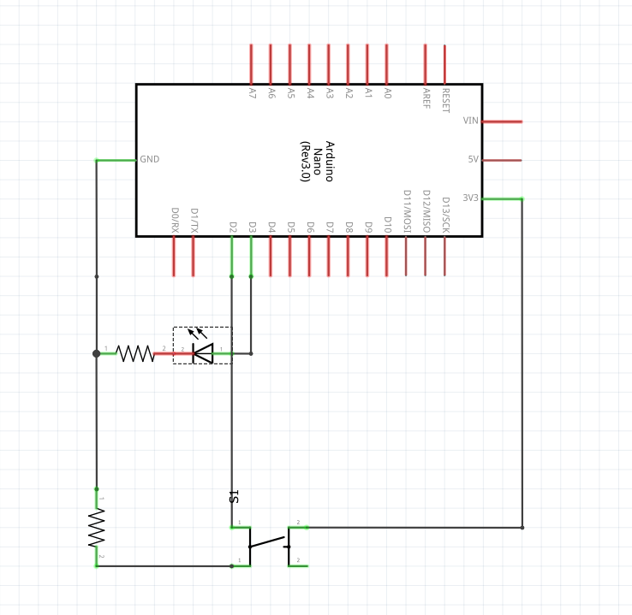
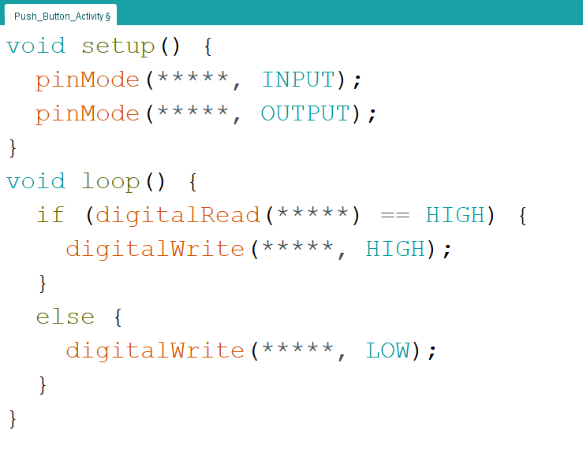
Activity Time: Hint
Notes:
Fix circuit and create a better code explanation

Slide 19
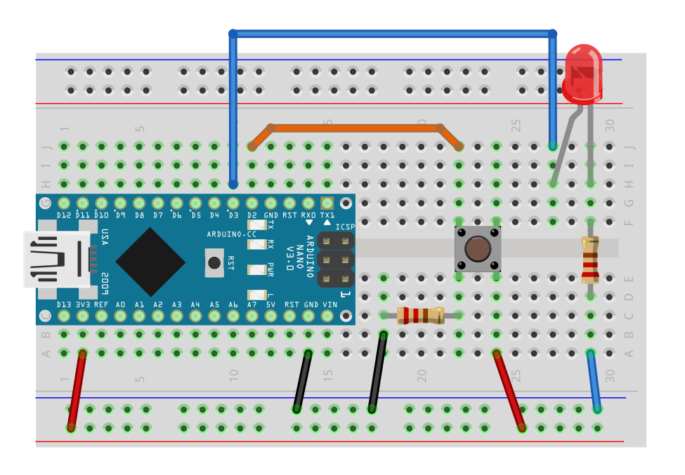
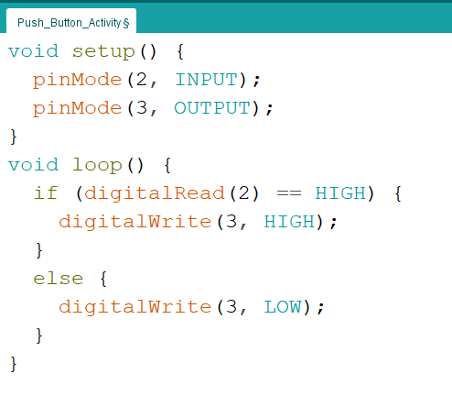
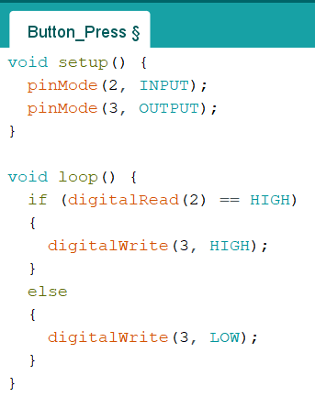
Activity Time: Solution

Slide 20
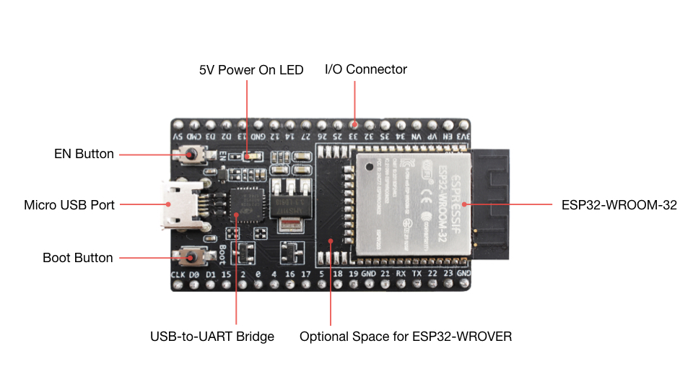
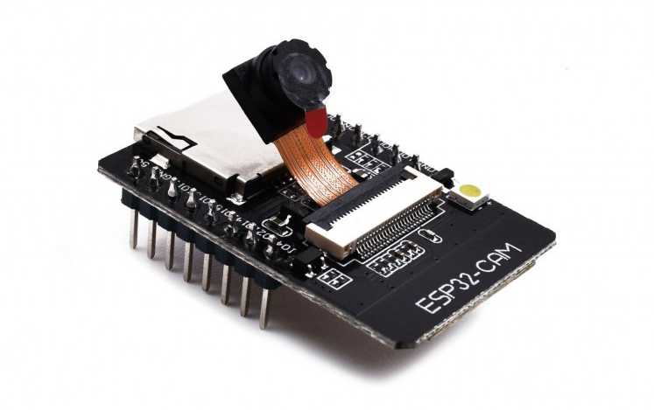
ESP32 and ESP32-CAM
ESP32
ESP32-CAM
Notes:
Fix circuit and create a better code explanation

Slide 21
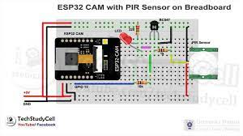
ESP32 Camera: Circuit
Notes:
Fix circuit and create a better code explanation

Slide 22
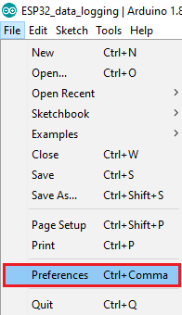
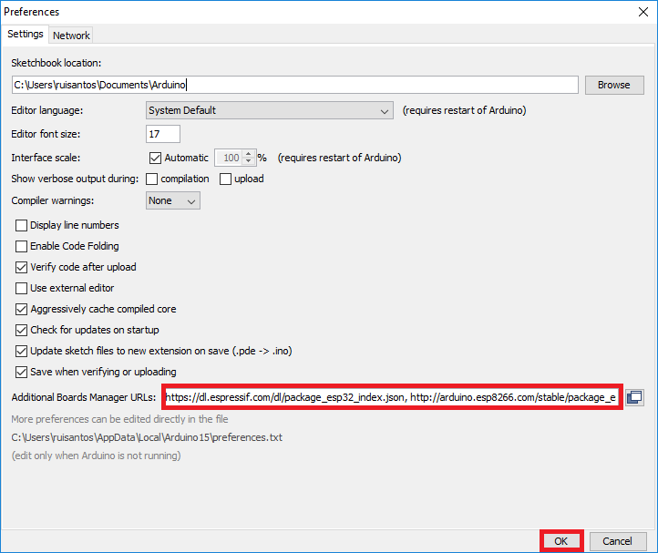
ESP32 Camera Setup
1. File → Preferences
2. Enter https://dl.espressif.com/dl/package_esp32_index.json
into Additional Boards Manager URLs
Notes:
Fix circuit and create a better code explanation

Slide 23
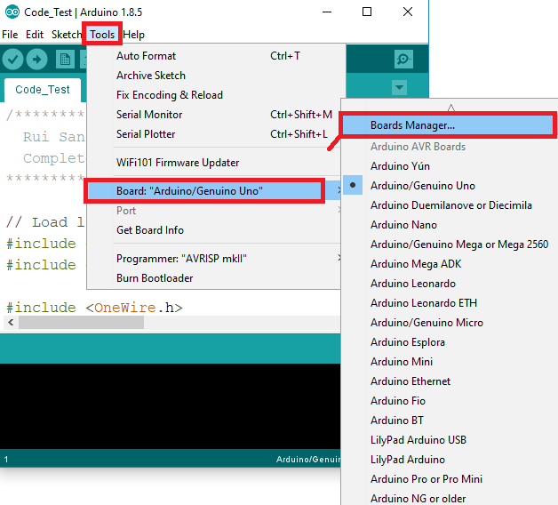
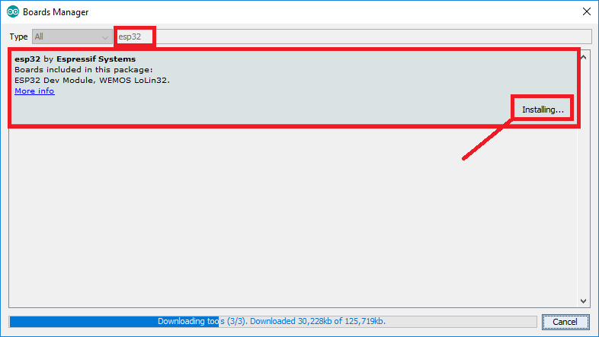
ESP32 Camera Setup
3. Tools → Board → Boards Manager
4. Search for and install “esp32”
Notes:
Fix circuit and create a better code explanation

Slide 24
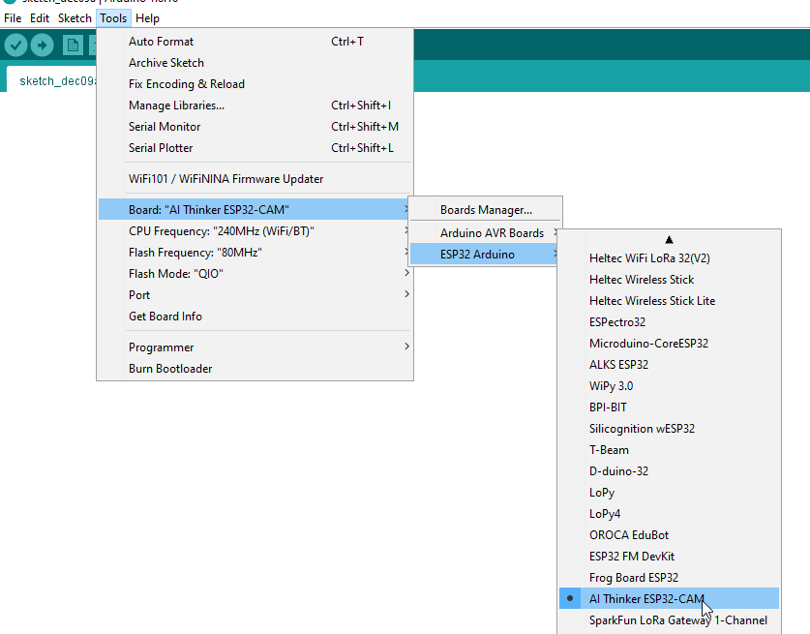
ESP32 Camera Setup
5. Tools → Board → ESP32 Arduino → AI-Thinker ESP32-CAM
Notes:
Fix circuit and create a better code explanation

Slide 25
ESP32 Camera Setup
6. Unplug the ESP32-CAM from your computer
7. Navigate to Tools → Port and keep note of the ports
8. Reconnect the ESP32-CAM to your computer
9. Navigate to Tools → Port and select the new port
Notes:
Fix circuit and create a better code explanation

Slide 26
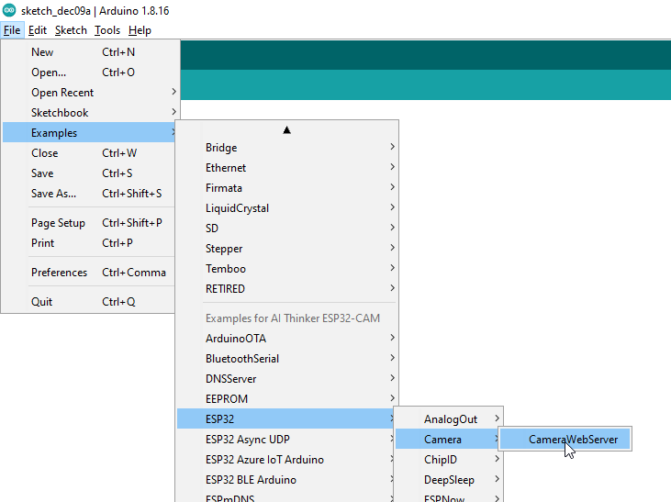
ESP32-CAM Web Server
10. File → Examples → ESP32 → Camera → CameraWebServer
Notes:
Fix circuit and create a better code explanation

Slide 27
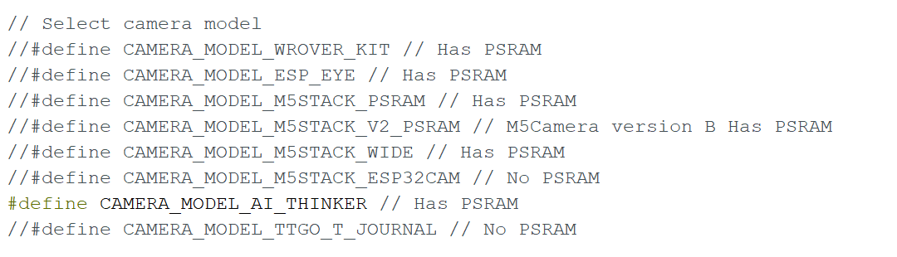
ESP32-CAM Web Server
11. Comment out the CAMERA_MODEL_WROVER_KIT line
12. Uncomment the CAMERA_MODEL_AI_THINKER line
Notes:
Fix circuit and create a better code explanation

Slide 28
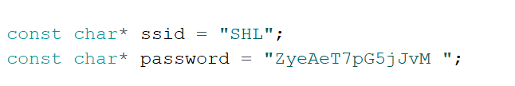
ESP32-CAM Web Server
13. Fill in the Wi-Fi details within the code
Notes:
Fix circuit and create a better code explanation

Slide 29
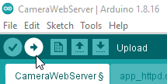
ESP32-CAM Web Server
14. Compile and upload your code to the ESP32-CAM
Notes:
Fix circuit and create a better code explanation

Slide 30
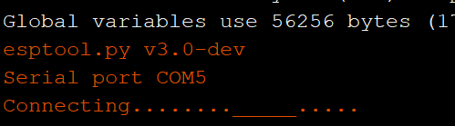
ESP32-CAM Web Server
15. When “Connecting ……_____........_____.......” appears. Click the reset button under the ESP32 Cam. If that doesn’t work, flip the switch and try again.
Notes:
Fix circuit and create a better code explanation

Slide 31
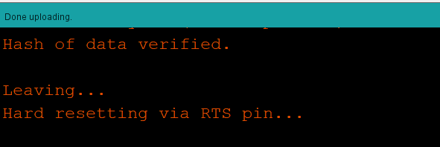
ESP32-CAM Web Server
16. Everything has been uploaded
Notes:
Fix circuit and create a better code explanation

Slide 32
ESP32-CAM Web Server
17. Open the serial monitor
18. Flip the switch on the breadboard and reset the ESP32-CAM
Notes:
Fix circuit and create a better code explanation

Slide 33
ESP32-CAM Web Server
19. Navigate to the IP address in the Serial Monitor.
Notes:
Fix circuit and create a better code explanation

Slide 34
ESP32-CAM Web Server
Smile!
You’re on camera :)
Notes:
Fix circuit and create a better code explanation

Slide 35
Homework :)
Notes:
Fix circuit and create a better code explanation

Slide 36
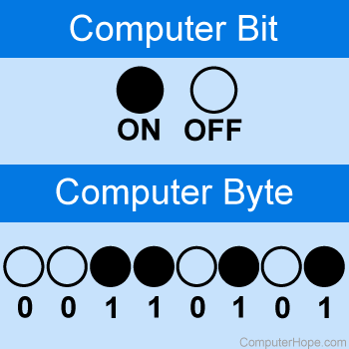

Bits and Bytes
Notes:
Fix circuit and create a better code explanation

Slide 37

Data Representation
Notes:
Fix circuit and create a better code explanation

Slide 38


Logic Gates
Notes:
Fix circuit and create a better code explanation

Slide 39

Brownout: Aiden
Notes:
Fix circuit and create a better code explanation

Slide 40
3.3V and 5V
Notes:
Fix circuit and create a better code explanation

Slide 41
Arduino Resources
Notes:
Fix circuit and create a better code explanation

Slide 42
ESP32 Camera Resources
Notes:
Fix circuit and create a better code explanation

Slide 43
Prevent Brownout and other issues on ESP32-Cam
Add capacitors to 3.3V and 5V rails
Use 5V USB/Serial configuration to power ESP32-Cam
Be patient with connection, try multiple times
Add a switch to D0 and GND to make uploading firmware easier
Ensure transmit pins are wired up correctly
Make sure ESP32 library is installed
https://randomnerdtutorials.com/esp32-cam-video-streaming-face-recognition-arduino-ide/
https://how2electronics.com/color-detection-tracking-with-esp32-cam-opencv/
https://robotzero.one/time-lapse-esp32-cameras/

